Slide 1
The Water Fall
The Water Fall

Slide 2
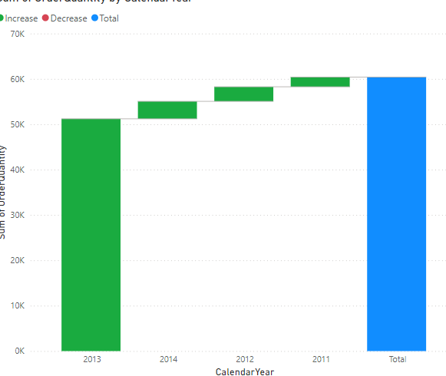
The Water Fall
Add a Water Fall to the scene and try to represent the SalesQuantity by adding it to the Y-Axis and CalendarYear from DimDate in Category

Slide 3
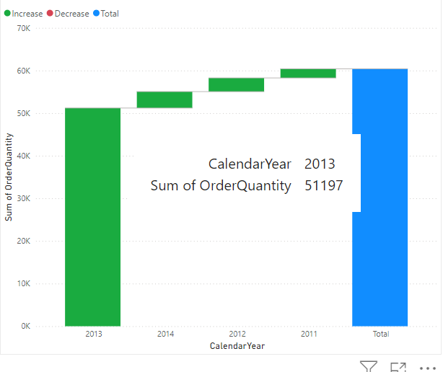
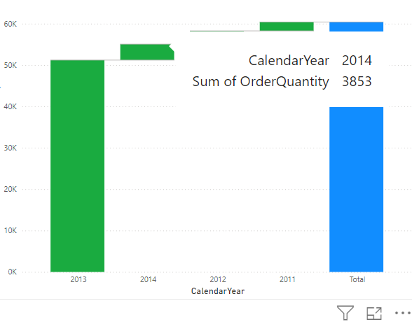
The Water Fall
Try hovering over the rectangles, there are two categories of rectangles, There are worms and there is only one that is blue and that represents the total

Slide 4
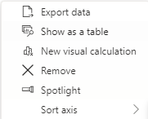
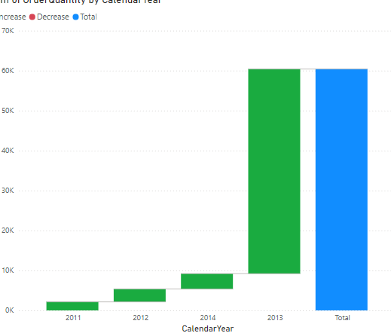
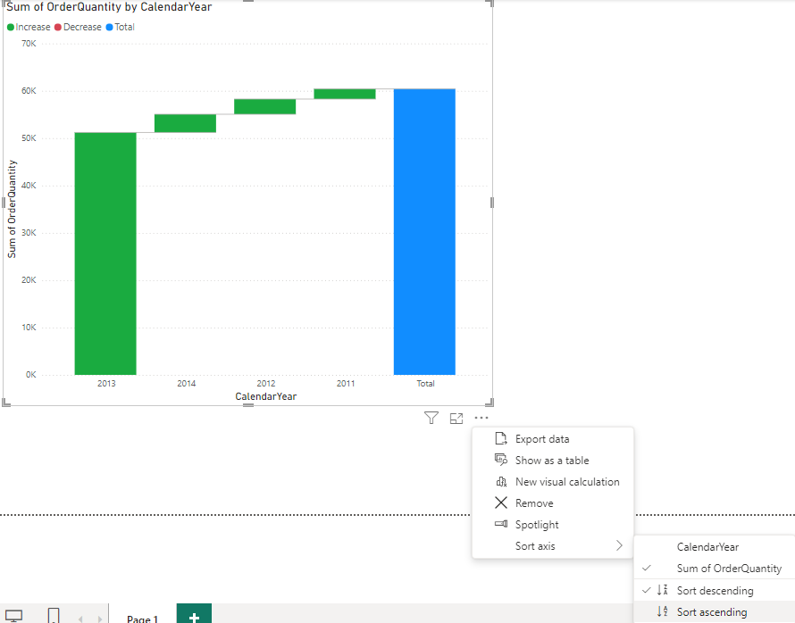

The Water Fall
Click More options and change the order of the years and then the quantities sold

Slide 5
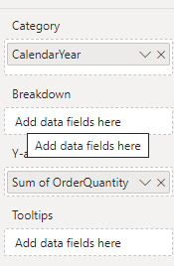
The Water Fall
Notice the presence of the Breakdown parameter in the fields section

Slide 6
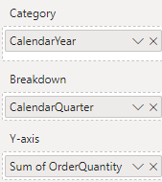
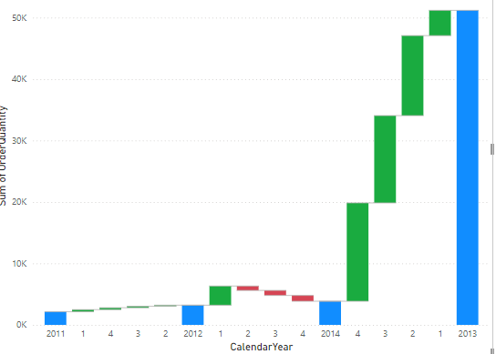
The Water Fall
Add the CalendarQuarter of the DimDate to the Breakdown parameter and notice the participation of each Quarter in the sales growth

Slide 7
The Water Fall
In the case of existence of depreciations the color of the rectangles changes to red
Substitute CalendarQuarter with CalendarSemester and try to analyze the data

Slide 8
Thank you
Thank you

